Slide 1

Forecasting Restaurant Data From the Census
By Scott Brown

Slide 2
Looking at the Data Set

Slide 3
Looking for Stationary Series and Seasonality
Month | SNt
1 | 0.895
2 | 0.891
3 | 1.007
4 | 0.989
5 | 1.041
6 | 1.016
7 | 1.011
8 | 1.032
9 | 0.963
10 | 0.992
11 | 0.999
12 | 1.164
Spikes at months:
1, 2, 5, 8, 9 and 12
Data is multiplicative and not stationary
Variance is fairly constant

Slide 4
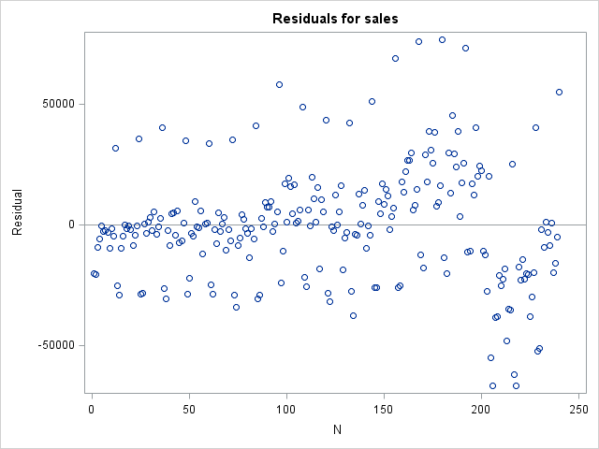
Data Set Problems
Residual Plot appears random with some fanning
Constant Variance assumption may not be violated

Slide 5
Intervention

Slide 6
Model Scenarios
Intervention between months 199 and 223 (July 2007 to July 2009) most likely caused by great recession. Points will be coded out of model.
Since intervention isn't extremely significant, model with full data will also be consider.
Simple Exponential smoothing model will also be considered.

Slide 7
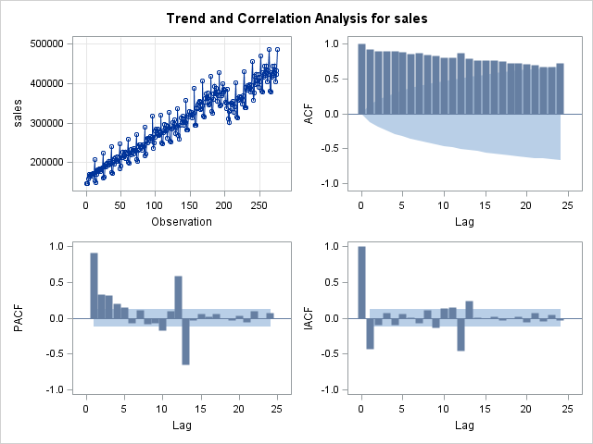
Original Model Sac and Spac
Sac dies down extremely slowly
Not stationary
Try first differencing

Slide 8
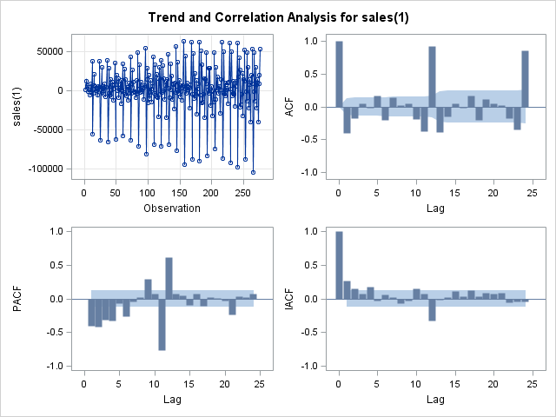
First Difference Sac and Spac
Sac has spikes around the seasonal points
Not stationary
Try seasonal differences

Slide 9
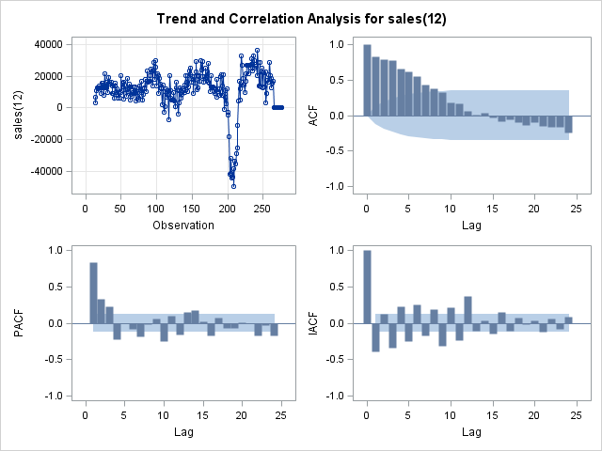
Seasonal Difference Sac and Spac
Sac dies down quickly compared to original model
Spac cuts off at 1 but does have spikes
Can be considered stationary

Slide 10
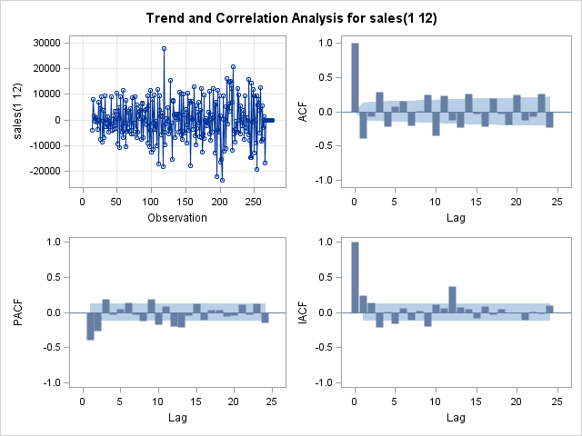
Seasonal First Difference Sac and Spac
Sac has oscillating pattern
Spac cuts off at 1 with some spikes
Not stationary

Slide 11
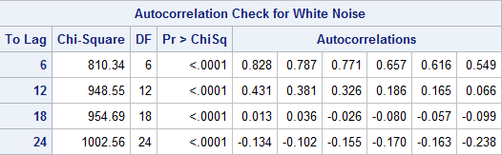
Checking Seasonal Differences
Residuals are auto-correlated
Auto-regressive model is needed
Moving average of 12 is included to offset seasonality

Slide 12
Going Backwards for Predictions
Data up to 2010, predicting 2011
Data up to 2011, predicting 2012
Data up to 2012, predicting 2013
Model with smallest forecasting error will be chosen to forecast 2014

Slide 13
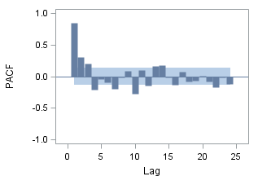
2011 Predictions
Model | s
MD | 2007.023
HW Multi | 2723.477
p(1,2,3,7) q(12) | 1588.817
p(1,2,3) q(12) | 1706.845
p(1,2) q(12) | 1802.489
p(1,2,3,7)(10) q(12) | 1618.911
p(1,2,3,4) | 1533.472
p(1,2,3) q(12) Adj | 1785.849
p(1,2) q(12) Adj | 1828.345
Arima of p(1,2,3,4) d(12) and q(0) yields best forecast
Intervention may be affecting data

Slide 14
2012 Predictions
Model | s
MD | 3315.394
HW Multi | 2520.231
p(1,3) q(12) | 3361.116
p(1) q(12) | 2205.572
p(1,10) q(12) | 1726.865
p(1,7,10) q(12) | 1796.966
p(1) q(12) Adj | 2842.807
p(1,10) q(12) Adj | 2376.911
p(1,10)(5) | 2036.453
Arima of p(1,10) d(12) q(12) yields best forecast.
Corresponds to seasonality in data
Month | SNt
1 | 0.895
2 | 0.891
5 | 1.041
12 | 1.164

Slide 15
2013 Predictions
Model | s
MD | 2265.242
HW Multi | 1893.379
p(1,10) q(12) | 1801.657
p(1,4,10) q(12) | 1865.550
p(1,10)(2) q(12) | 1913.557
p(1,10)(5) q(12) | 1764.008
p(1,2,3,10) q(12) Adj | 2777.209
p(1,10) q(12) Adj | 2264.222
p(1,2,10) q(12) | 2078.356
Arima of p(1,10)(5) d(12) q(12) yields best forecast
Corresponds to seasonality in data
Month | SNt
1 | 0.895
2 | 0.891
5 | 1.041
12 | 1.164

Slide 16
Model Equations
2011: z(t) = (1 - ϕ1*B1 - ϕ2*B2 - ϕ3*B3 - ϕ4*B4) + δ + a(t)
2012: z(t) = (1 - ϕ1*B1 - ϕ10*B10) - (1 - θ12*a12) + δ + a(t)
2013: z(t) = (1 - ϕ1*B1 - ϕ10*B10)*(1 - ϕ5*B5) - (1 - θ12*a12) + δ + a(t)

Slide 17
Comparing the Models
Model | N | 2011 | 2012 | 2013 | Avg S
p(1,2,3,4) d(12) q(0) 2010 | 228 | 1524.257 | 3521.764 | 2208.172 | 2418.064
p(1,10) d(12) q(12) 2011 | 240 |  | 1726.865 | 1247.469 | 1487.167
p(1,10)(5) d(12) q(12) 2012 | 252 |  |  | 1764.088 | 1764.088
2011 Model will be used
Compare to HW α=.58 γ=δ=0

Slide 18
2014 Model Projections
N | Month | p(1,10) q(12) 2011 | HW 2013
277.000 | January | 390760.000 | 378866.451
278.000 | February | 397470.900 | 377167.711
279.000 | March | 440703.400 | 426941.997
280.000 | April | 428154.000 | 421890.869
281.000 | May | 447683.400 | 444112.238
282.000 | June | 435788.500 | 436062.997
283.000 | July | 433071.500 | 434888.106
284.000 | August | 446333.100 | 444156.056
285.000 | September | 419191.300 | 415633.006
286.000 | October | 429455.400 | 428538.961
287.000 | November | 438992.900 | 432075.650
288.000 | December | 495214.700 | 506315.298

Slide 19
2014 Model Projections

Slide 20
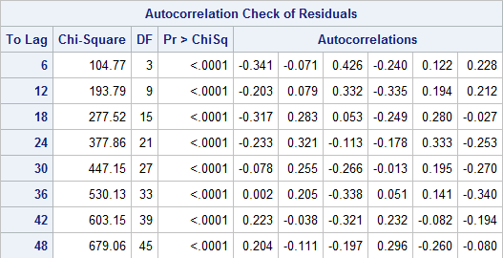
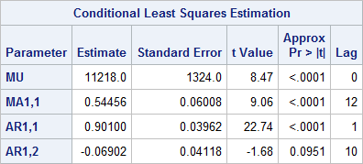
Model Shortcomings
Residuals are not white noise
AR(10) is not significant @ α=.05
Model is fitted to the data
Intervention included
Adequate model but needs additional work

